Slide 1
HEALTH POLICY AND LAW IN THE UNITED STATES NURSING HOMES

Slide 2
Sources of Ideas
Ideas are generated by identifying the gap or serious health issues such as scandals and exposes concerning fraud, abuse , and poor-quality care in nursing homes by healthcare experts
The healthcare experts explores various strategies of filling the gap or solving the health issues in the nursing homes through research or brainstorming
Healthcare professional consult all the stakeholders and suggest ways of improving the nursing homes
If the all stakeholders agree with the healthcare professionals the idea is documented as regulations and rules to ensure effectiveness and efficiency of nursing homes
The idea is implemented and governs the nursing homes institutions

Slide 3
Piloting of the Rules and Regulations
Few nursing homes facilities are selected for piloting
The piloting process is closely monitored and supervised by relevant government agencies
During the supervision and monitoring the established new regulations and rules are assessed on its applicability and practicability for possible adoption in the rest of nursing homes facilities

Slide 4
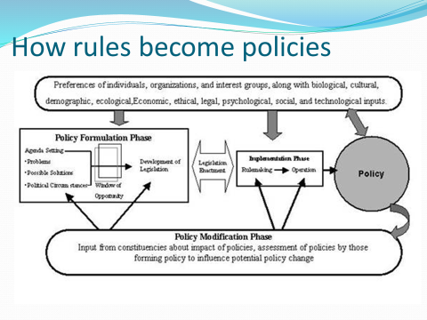
How Rules and Regulations Becomes Health Policy
After successful piloting the rules and regulations are taken to the United States Department of Health, Education, and Welfare for further evaluation and policy formulation
The Department of Health, Education, and Welfare carries research to ascertain if the new rules and regulations can be adopted and applied in other nursing homes in the country
If the policy makers are satisfied that the new regulations and rules are good and applicable they adopt and recommend for operationalization and implementation

Slide 5
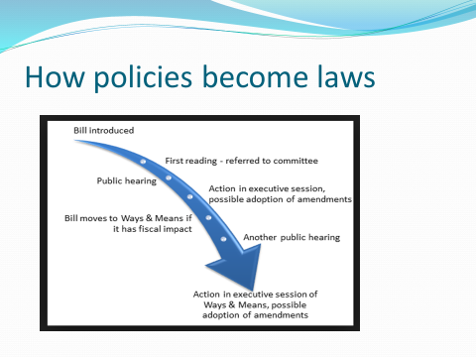
How Policy Becomes Law at the State Level
After the implementation of the policy, United States Department of Health, Education, and Welfare drafts a bill and takes it to the legislative assembly at the local state level for debate
In the assembly the policy is subjected to first, second and third reading
If necessary changes or amendments are made before passing it into the law

Slide 6
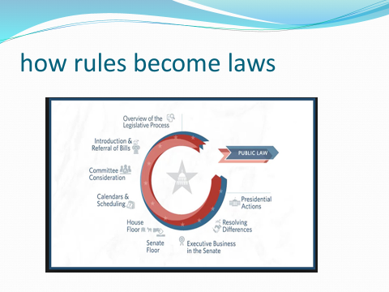
How Rules and Regulations Becomes the Law at National Level
If the national government considers the law at the state as good for all the citizens it may take it and do
Further research and evaluation is done to ensure it is practical and applicable in all the nursing homes across the country
If the national government is convinced that the law can be adopted in all the facilities it is taken to the U.S Congress
In the U.S Congress it may passed to law with or without amendments or changes
Ounces it is enacted into the law it will govern the operations of all nursing homes in the United States

Slide 7
References
Hawes, C., More., V., Phillips, C.D., Fries, B.E., Morris, J.N., Steele-Friedlob, E., Greene, A.M., and Nennstiel, M. (1997). The OBRA-87 nursing home regulations and the implementation of the resident assessment instrument: Effects on process quality. Journal of the American Geriatric Society, 45: 977–985.
Walshe, K. (2001). Regulating US nursing homes: are we learning from experience?. Health Affairs, 20(6), 128-144

